Slide 1

第1部分 强化学习基本概念和工具
强化学习实践
强化学习基本概念
强化学习的目标和求解工具

Slide 2
Lecture 2: Bellman Equation
In this lecture:
A core concept: state value
state value -> action value
A fundamental tool: the Bellman equation
Bellman equation: Derivation
Bellman equation: Matrix-vector form
Bellman equation: Solve the state values

Slide 3

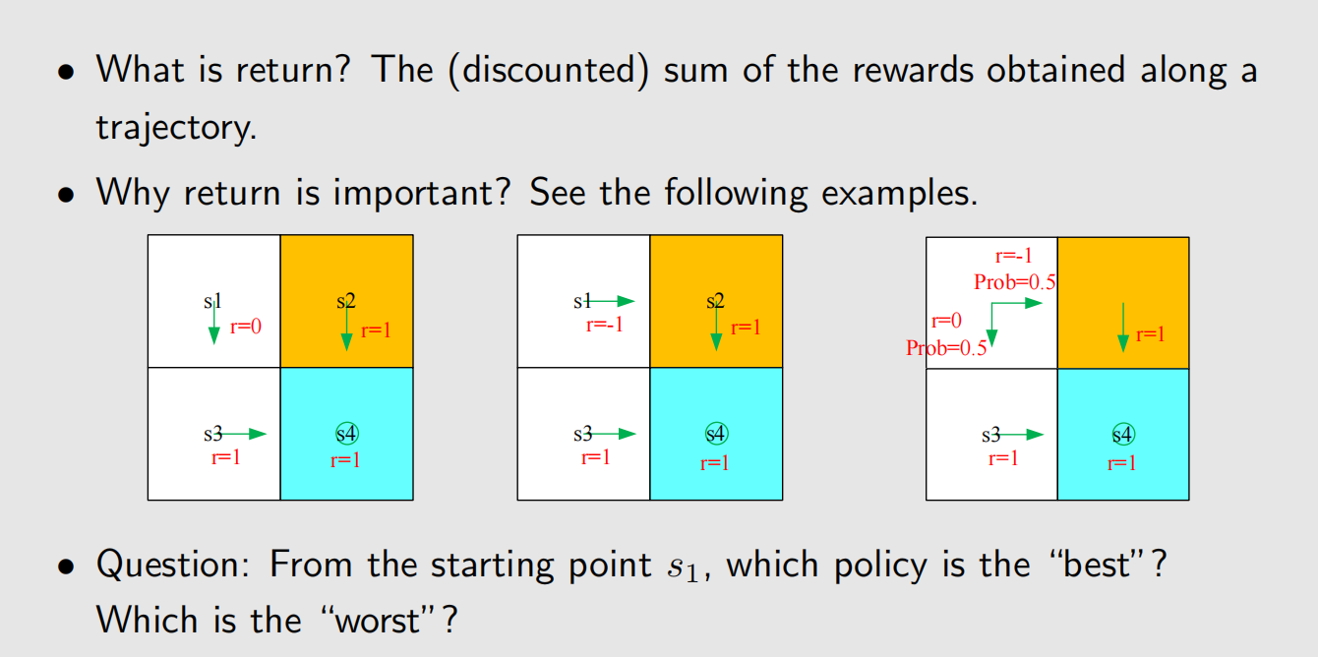
Motivating example 1: return & return is important!

Slide 4
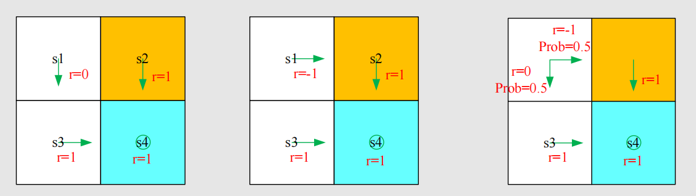
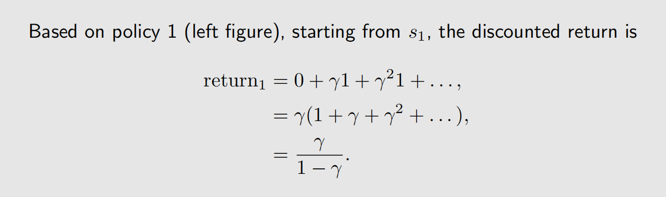
Motivating example 1: return & return is important!

Slide 5
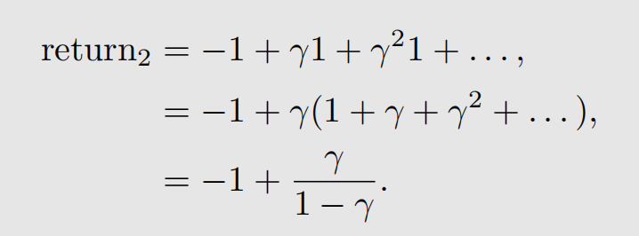
Motivating example 1: return & return is important!
Exercise: Based on policy 2 (middle figure), starting from s1, what is
the discounted return?
Answer:

Slide 6
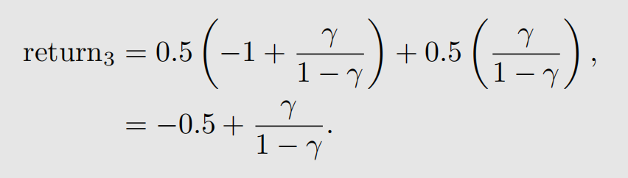
Motivating example 1: return & return is important!
Policy 3 is stochastic!
Exercise: Based on policy 3 (right figure), starting from s1, the
discounted return is

Slide 7
Motivating example 1: return & return is important!
In summary, starting from s1,
return₁ > return₃ > return₂
The above inequality suggests that the first policy is the best and the
second policy is the worst, which is exactly the same as our intuition.
Calculating return is important to evaluate a policy.

Slide 8
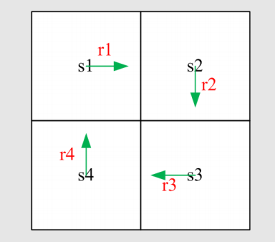
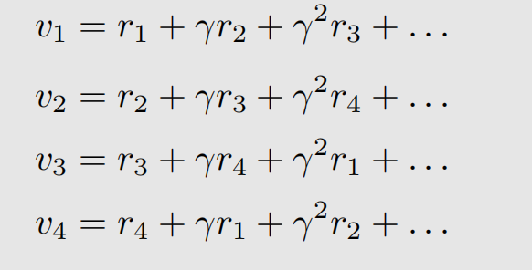
Motivating example 2: How to calculate return
Method 1: by definition
Let v_{i} denote the return obtained starting from s_{i} (i = 1, 2, 3, 4)

Slide 9
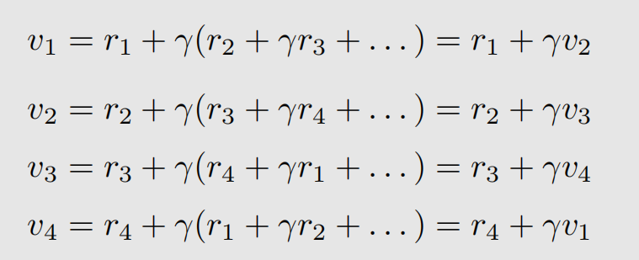
Motivating example 2: How to calculate return
Method 2: v_{i} obtained is related with some other s_{j} (j ≠ 1, 2, 3, 4)
The returns rely on each other. Bootstrapping

Slide 10
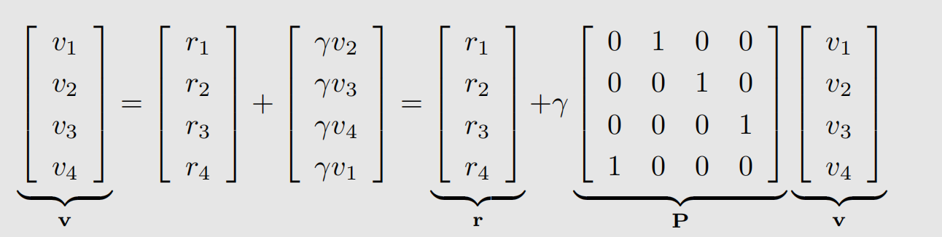
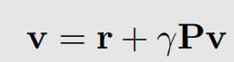
Motivating example 2: How to calculate return
Method 2: v_{i} obtained is related with some other s_{j} (j ≠ 1, 2, 3, 4)
How to solve these equations? Write in the following matrix-vector form:
which can be rewritten as
This is the Bellman equation (for this specific deterministic problem)!!
• Though simple, it demonstrates the core idea: the value of one state relies on the values of other states.
• A matrix-vector form is more clear to see how to solve the state values

Slide 11
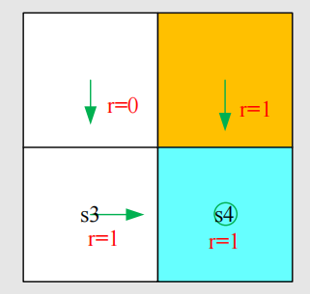
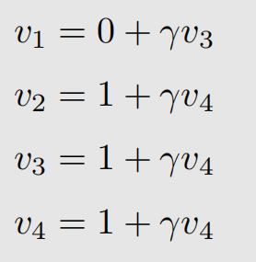
Motivating example 2: How to calculate return
Exercise: Consider the policy shown in the figure. Please write out the relation among the returns (that is to write out the Bellman equation)
Answer:
Exercise: How to solve them? We can first calculate v₄, and then v₃, v₂, v₁.

Slide 12
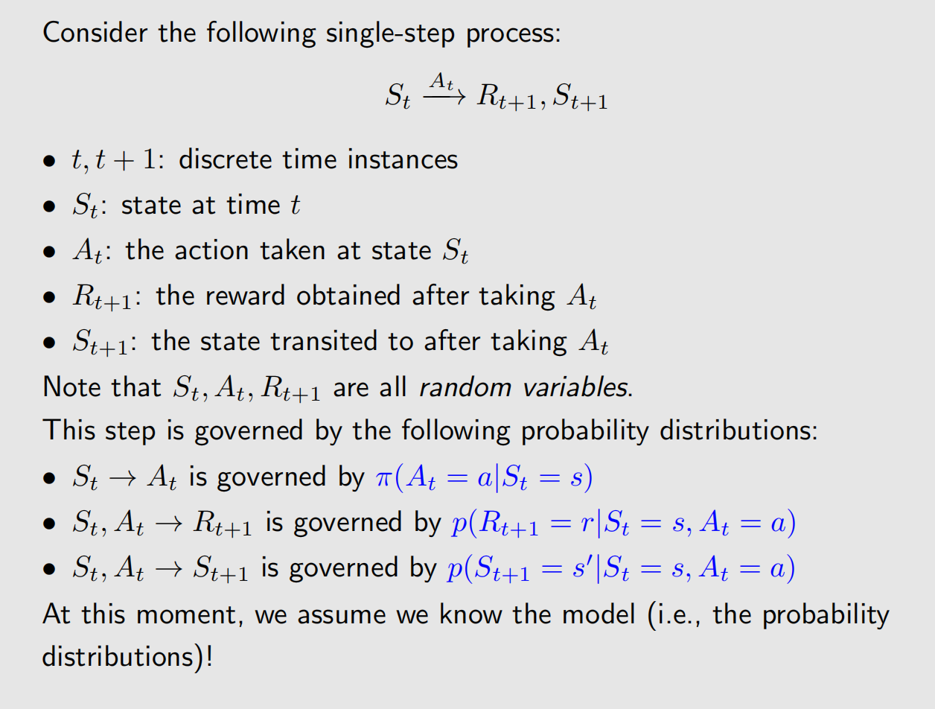
Overview some notions

Slide 13
Overview some notions

Slide 14
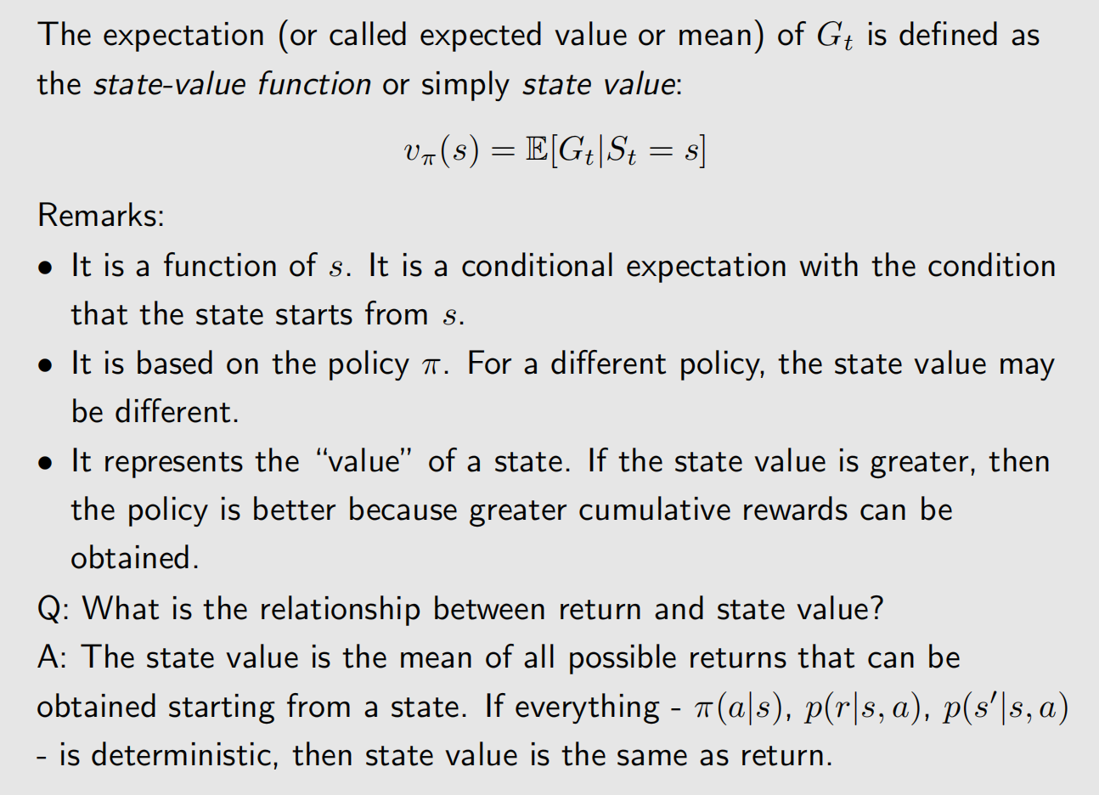
State value

Slide 15
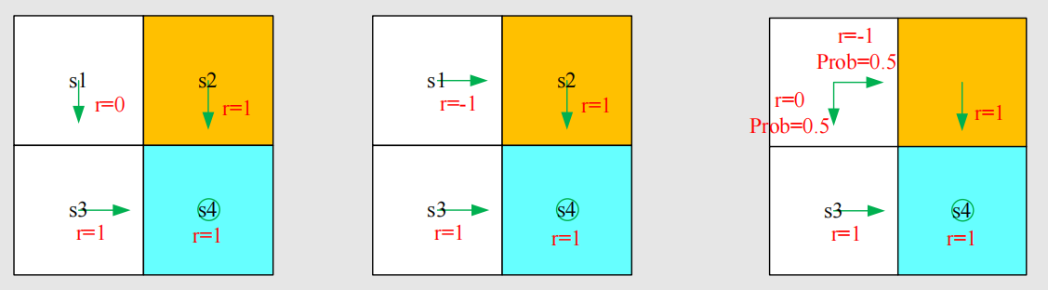
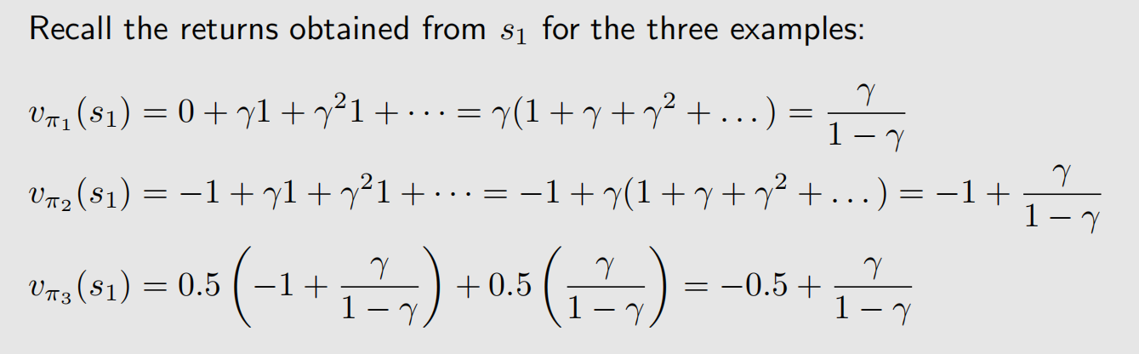
State value
Example

Slide 16
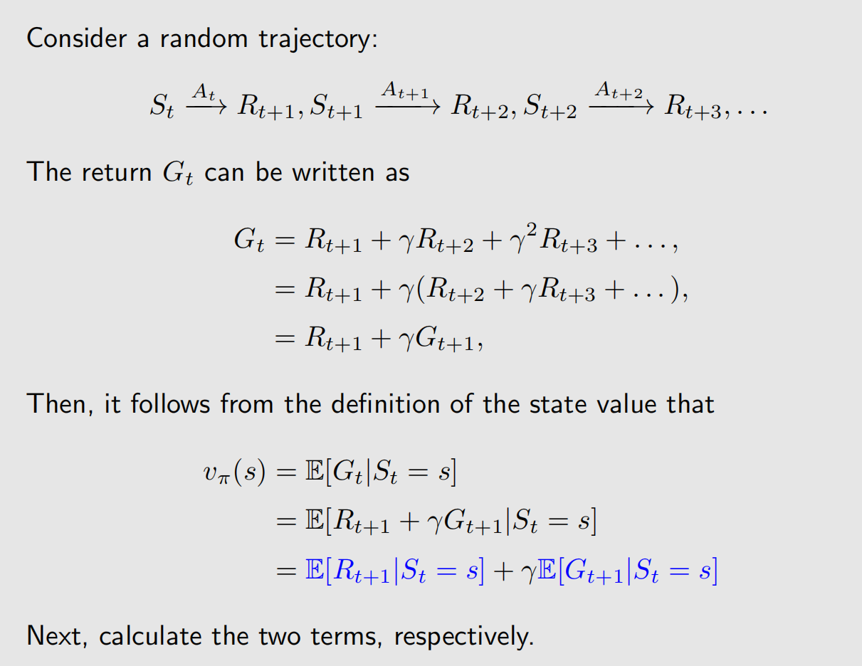
Deriving the Bellman equation

Slide 17
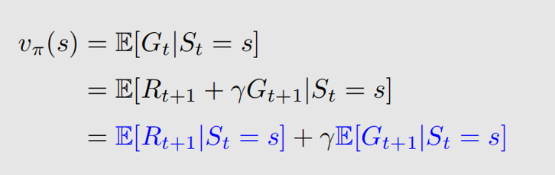
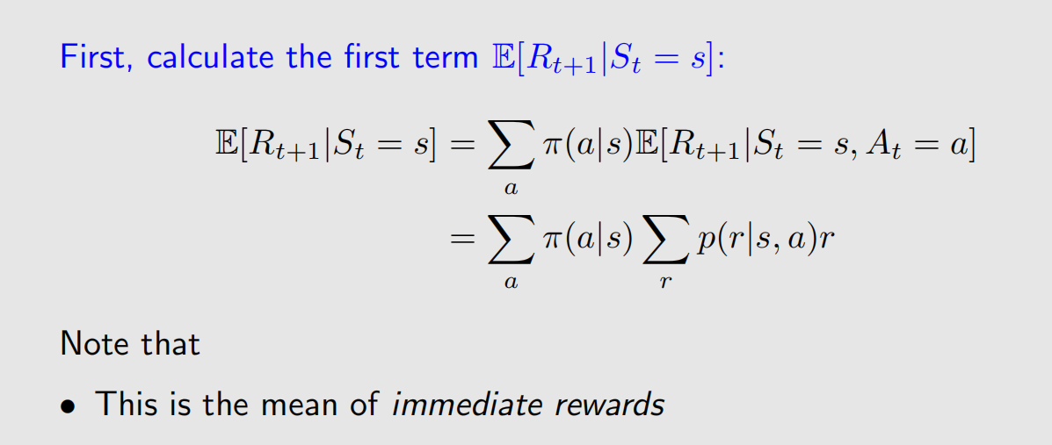
Deriving the Bellman equation

Slide 18
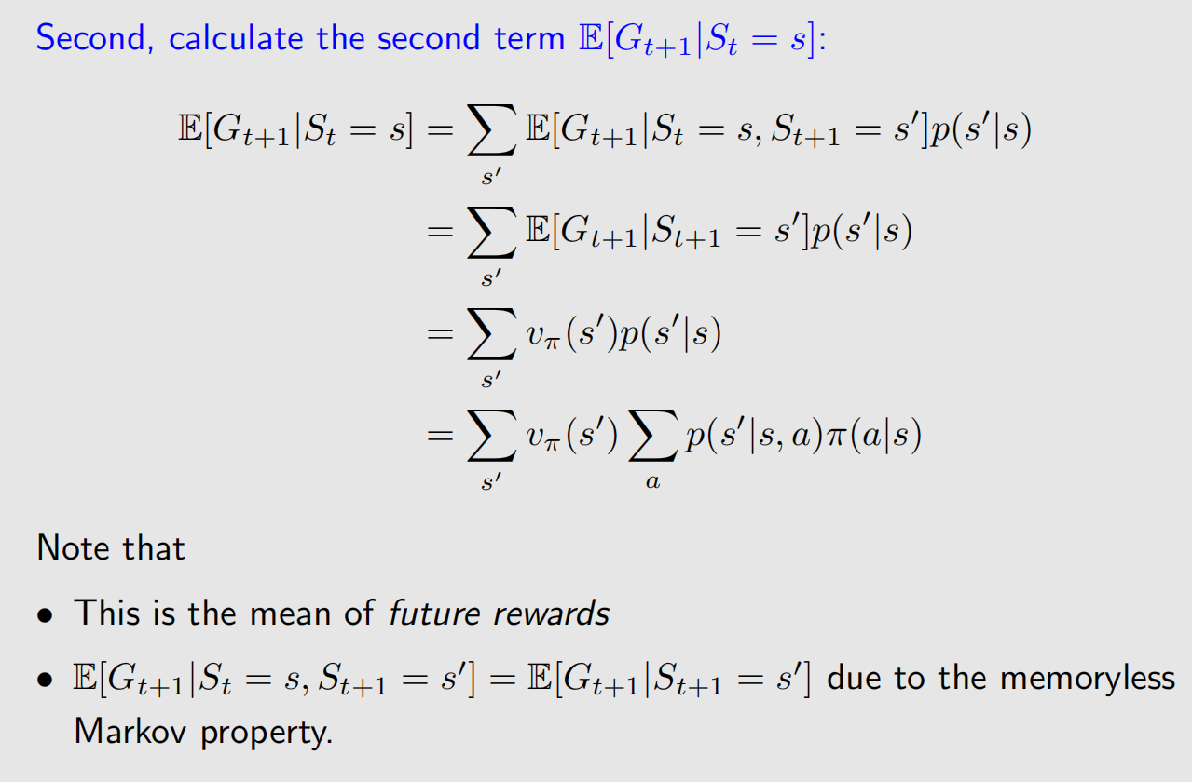
Deriving the Bellman equation

Slide 19
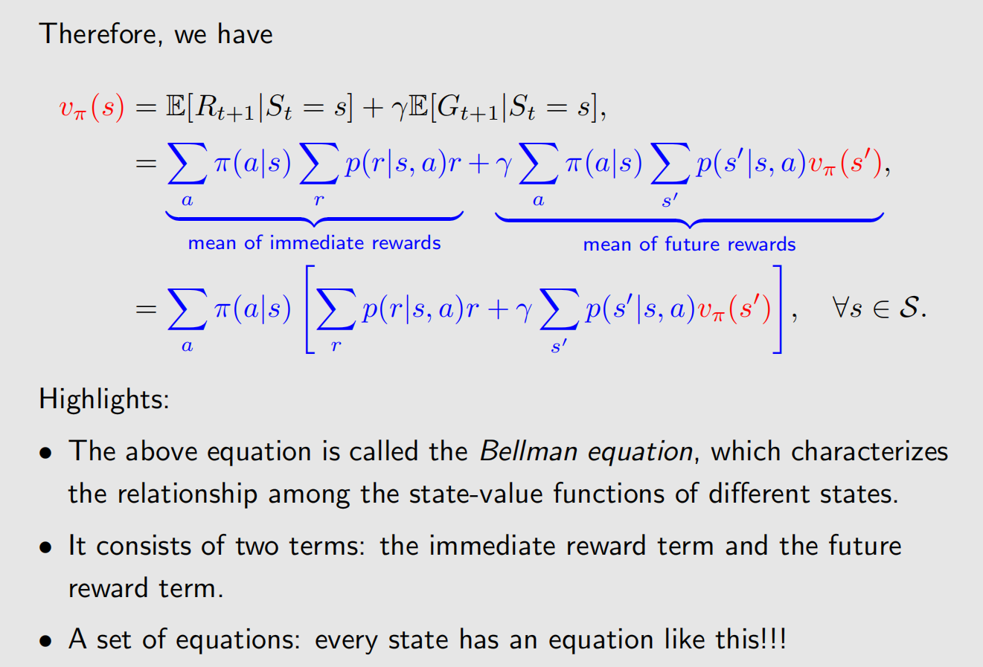
Deriving the Bellman equation

Slide 20
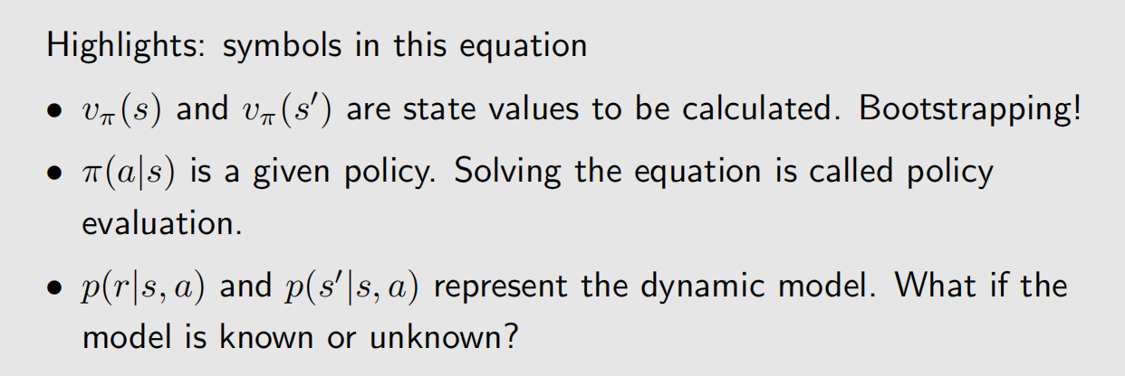
Deriving the Bellman equation

Slide 21
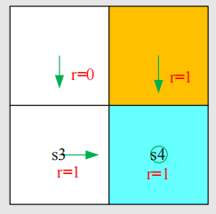
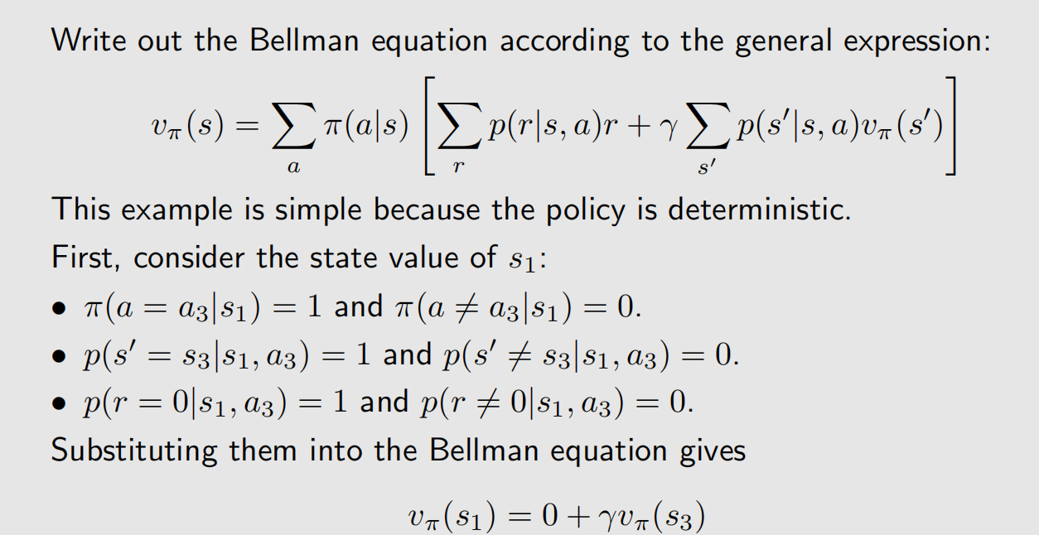
An illustrative example

Slide 22
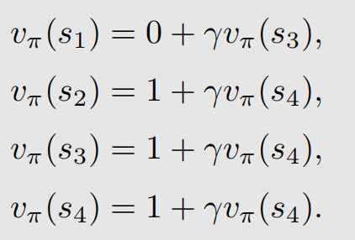
An illustrative example
Similarly, it can be obtained that

Slide 23
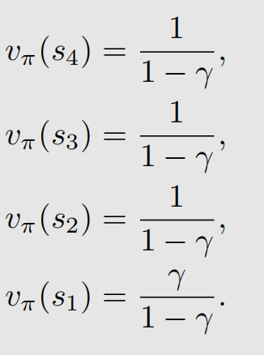
An illustrative example
How to solve them?
Solve the above equations one by one from the last to the first:

Slide 24
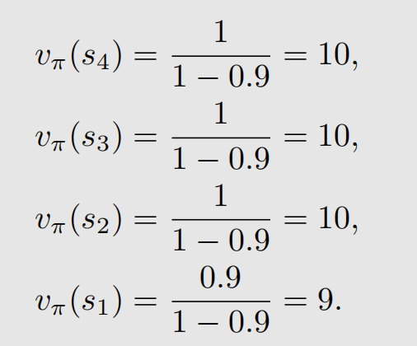
An illustrative example
How to solve them?
If γ = 0.9, then
What to do after we have calculated state values?
Be patient (calculating action value and improve policy)

Slide 25
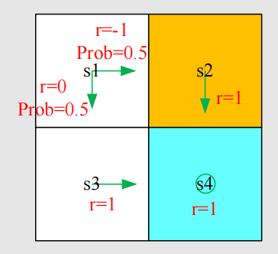
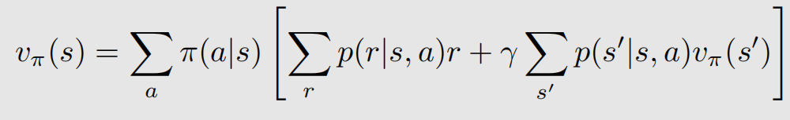
Exercise
write out the Bellman equations for each state.
solve the state values from the Bellman equations.
compare with the policy in the last example.

Slide 26
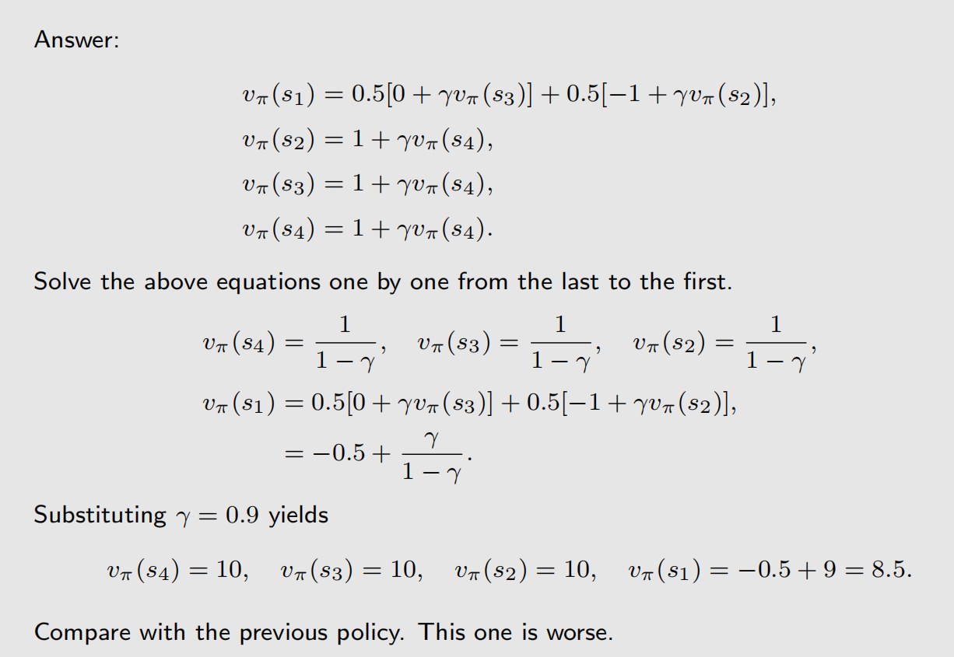
Exercise

Slide 27
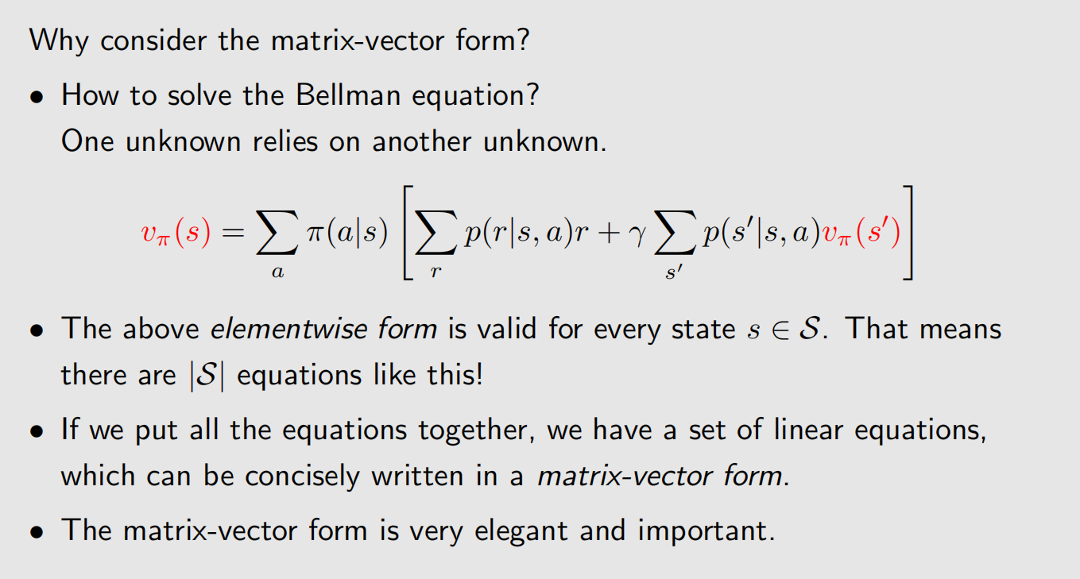
Bellman equation: Matrix-vector form

Slide 28
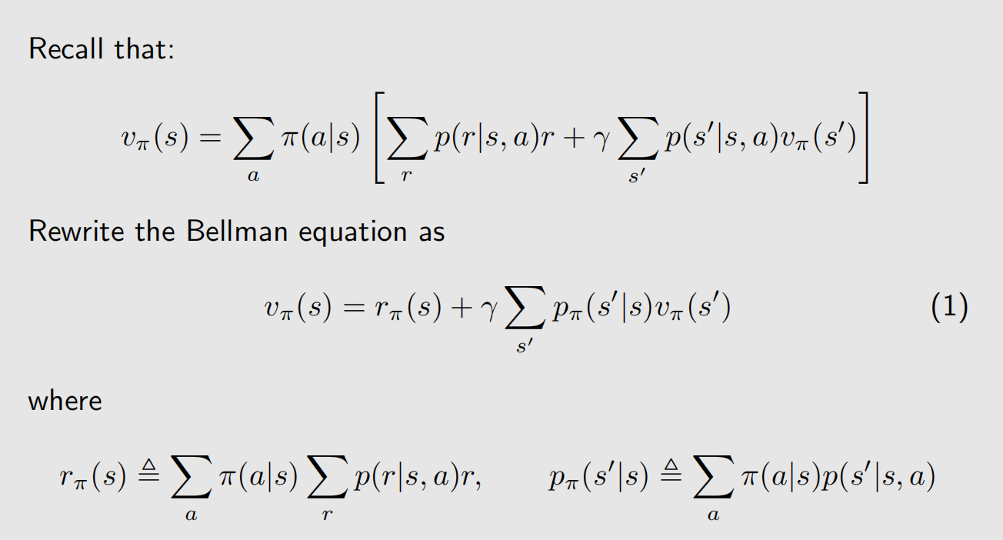
Bellman equation: Matrix-vector form

Slide 29
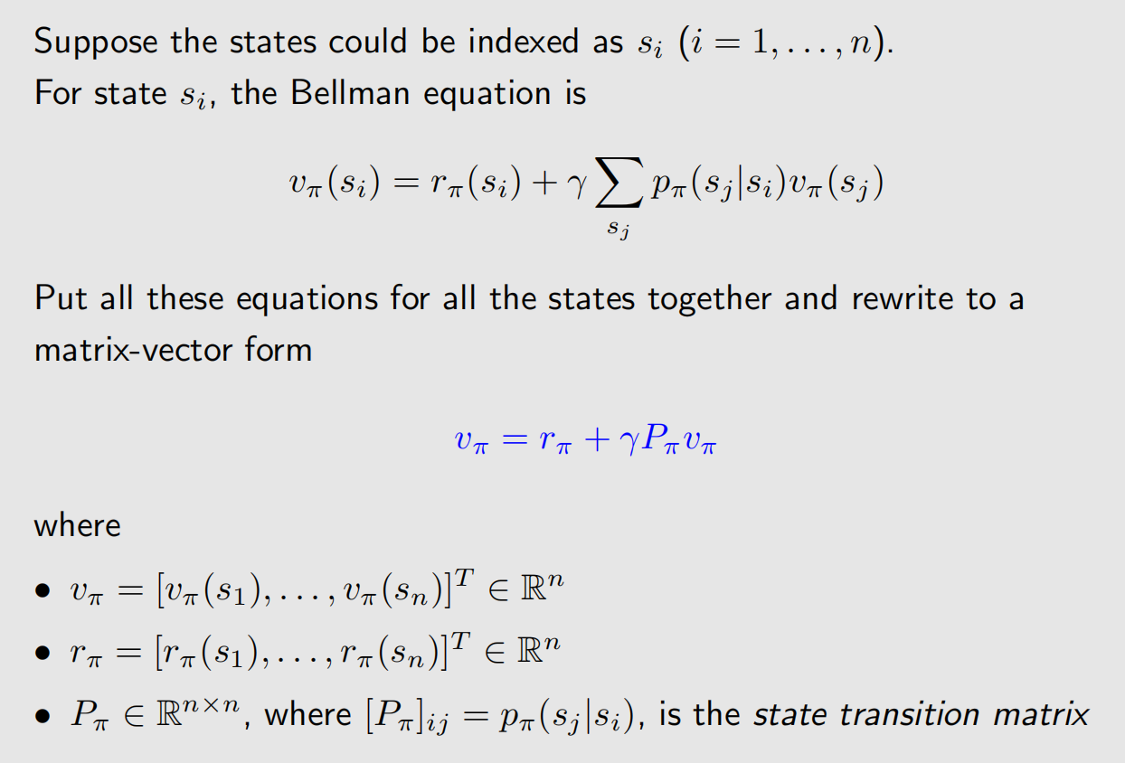
Bellman equation: Matrix-vector form

Slide 30
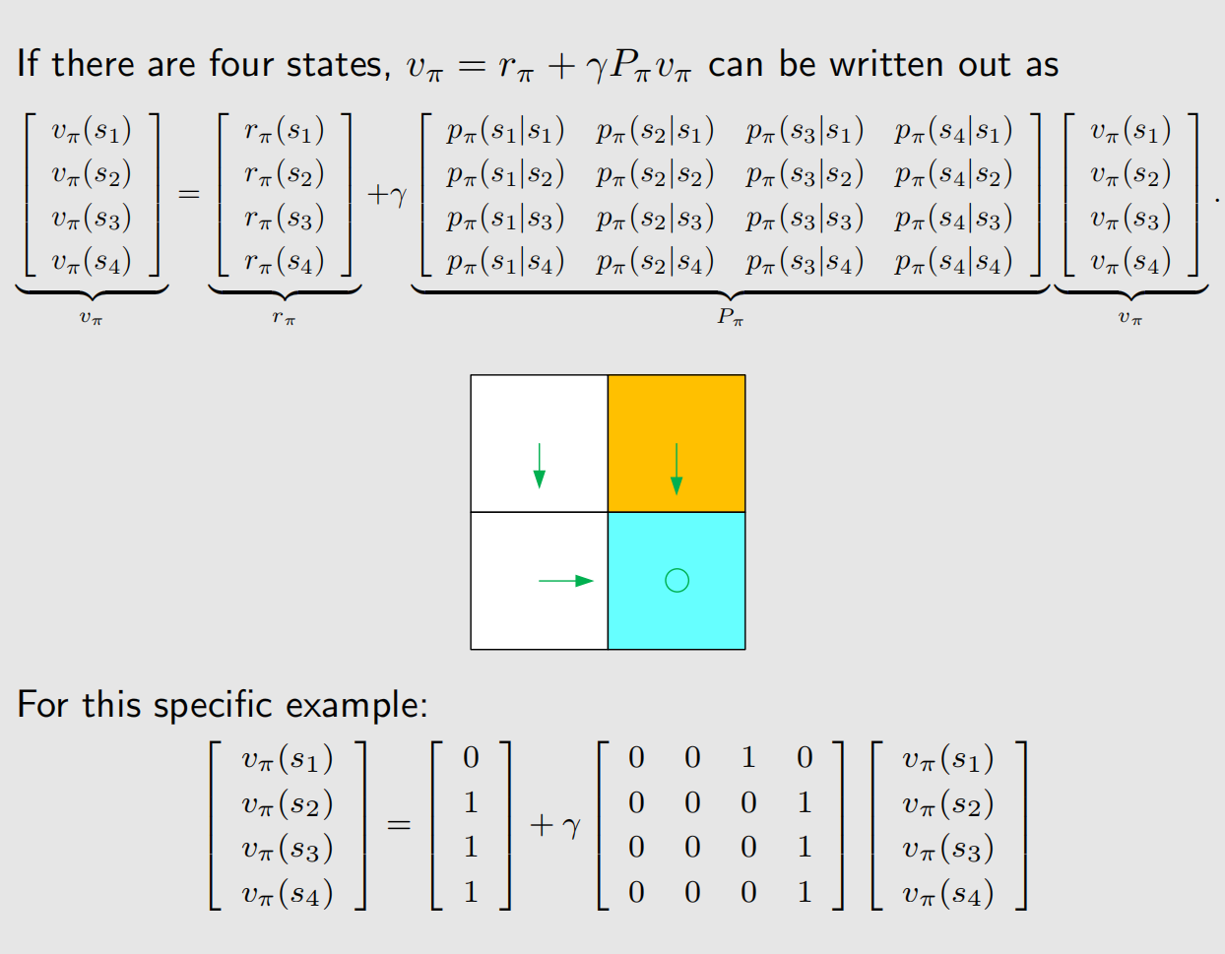
Bellman equation: Matrix-vector form

Slide 31
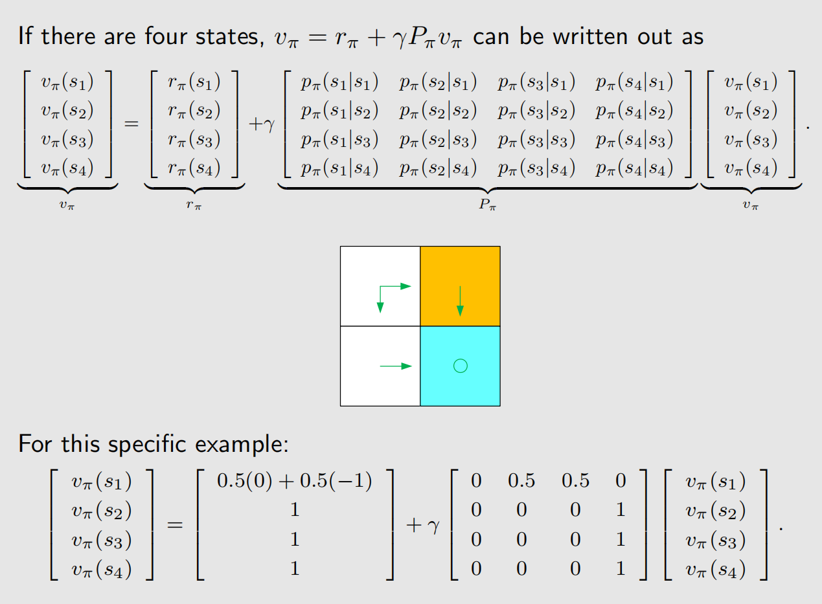
Bellman equation: Matrix-vector form

Slide 32
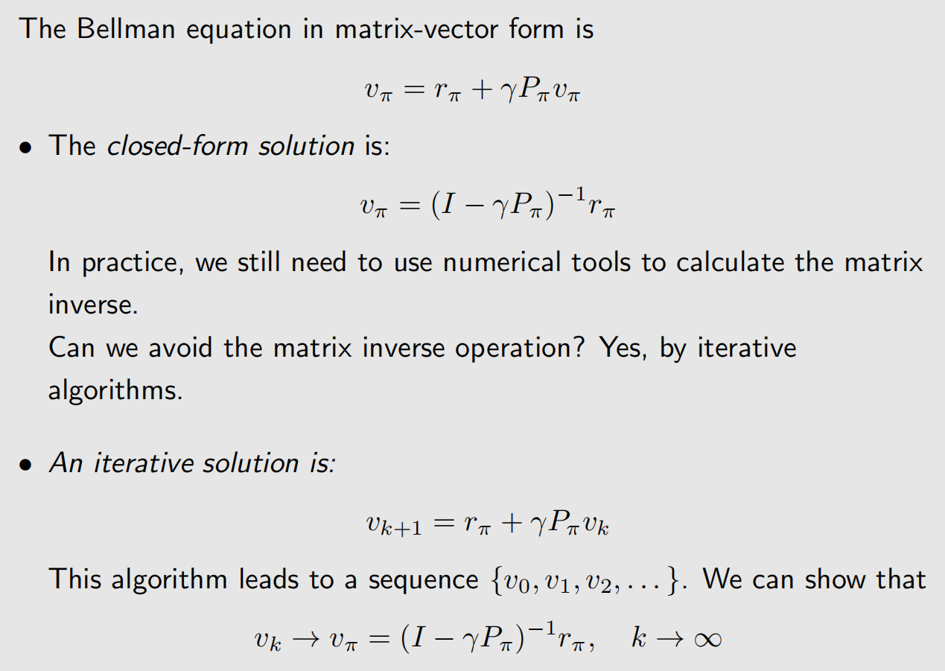
Bellman equation: Solve the state values
Why to solve state values?
• Given a policy, finding out the corresponding state values is called policy evaluation! It is a fundamental problem in RL. It is the foundation to find better policies.
• It is important to understand how to solve the Bellman equation.
Solution:
• closed-form solution
• iterative solution

Slide 33
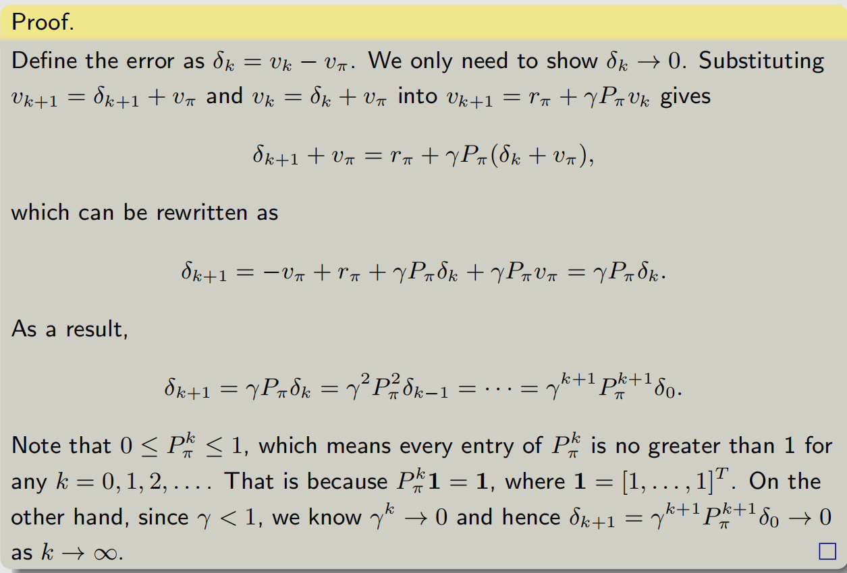
Bellman equation: Solve the state values
Solution:
• closed-form solution
• iterative solution

Slide 34
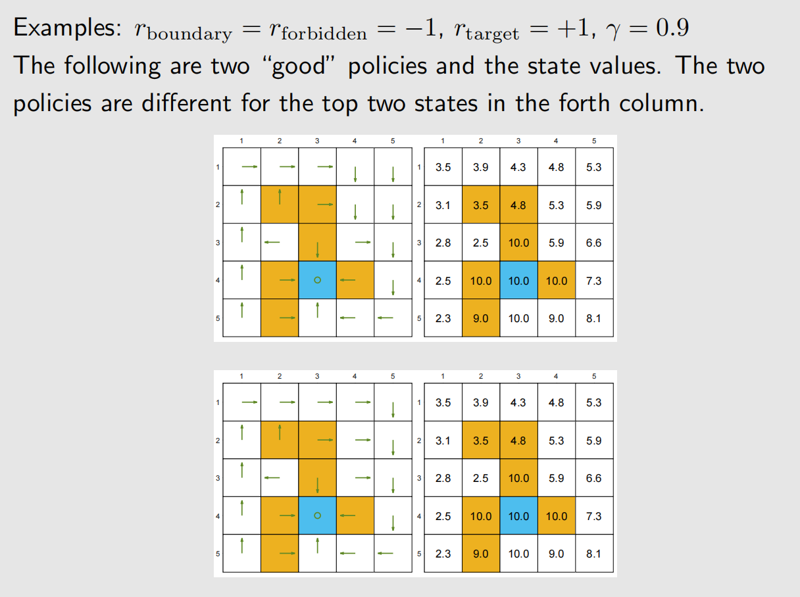
Bellman equation: Solve the state values

Slide 35
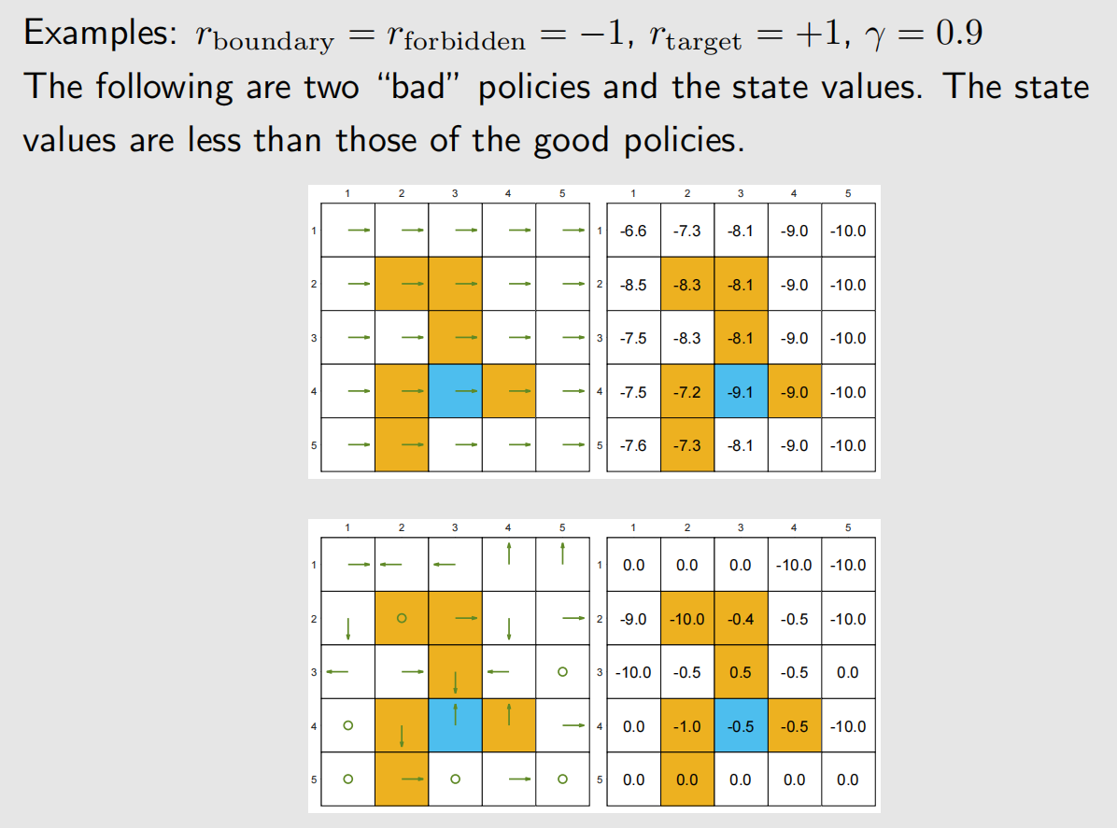
Bellman equation: Solve the state values

Slide 36
Action value
From state value to action value:
• State value: the average return the agent can get starting from a state.
• Action value: the average return the agent can get starting from a state and taking an action.
Why do we care action value? Because we want to know which action is better.
We will frequently use action values to update policies.

Slide 37
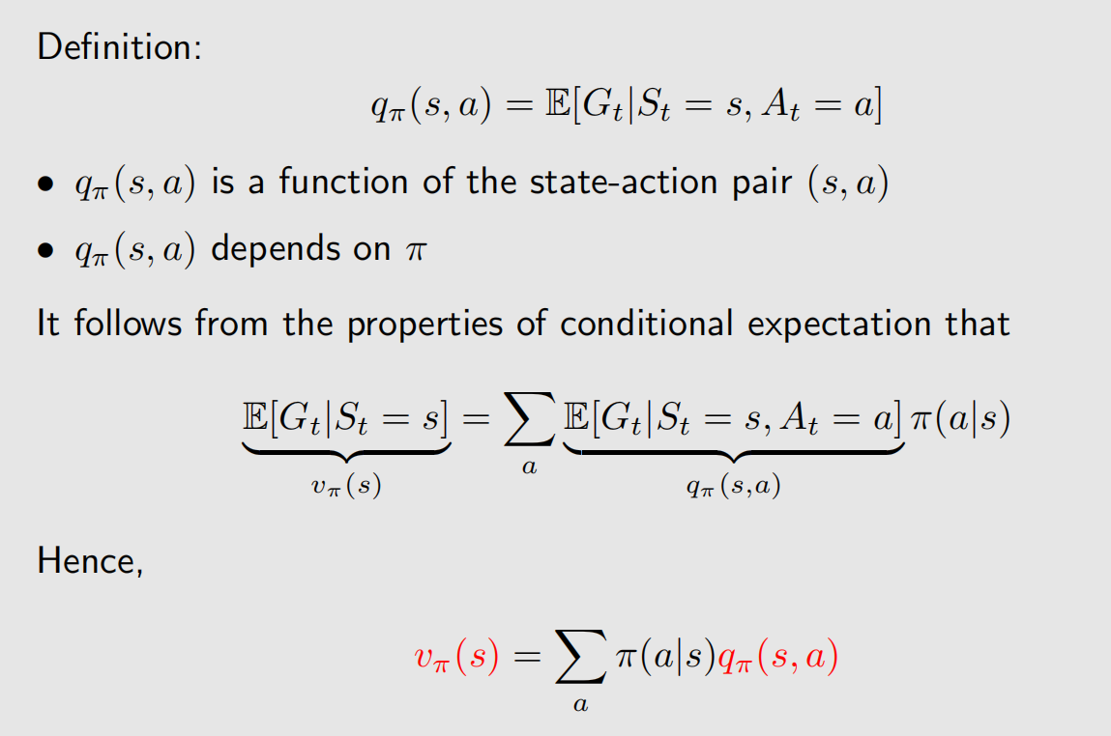
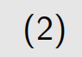
Action value

Slide 38
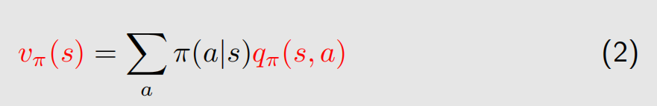
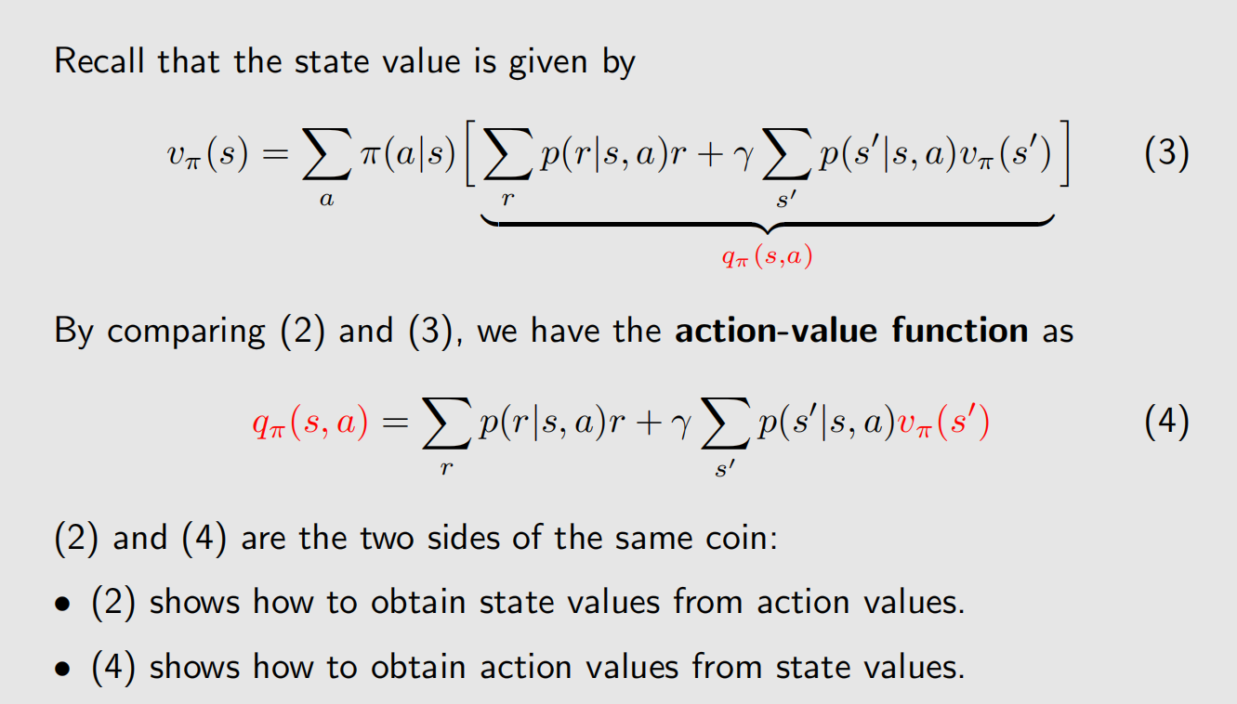
Action value

Slide 39
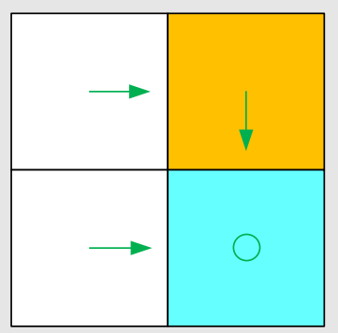
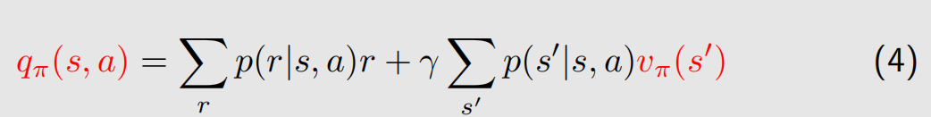
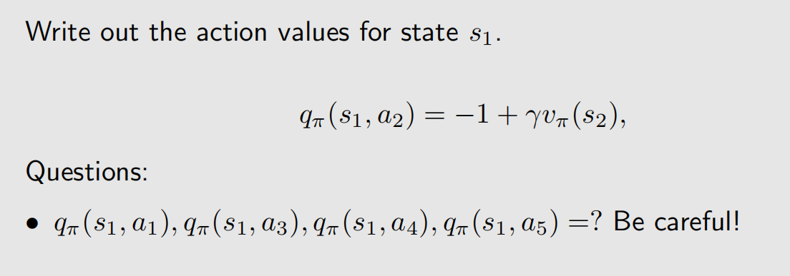
Illustrative example for action value

Slide 40
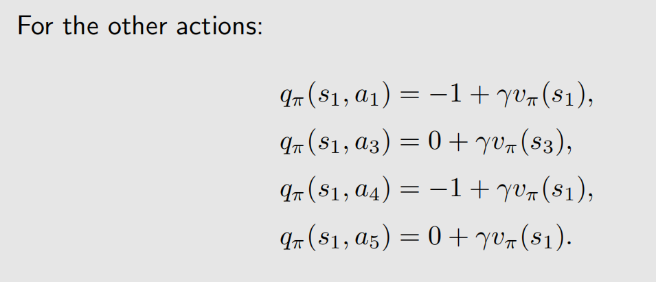
Illustrative example for action value

Slide 41
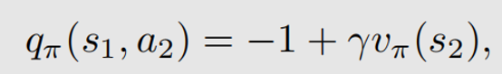
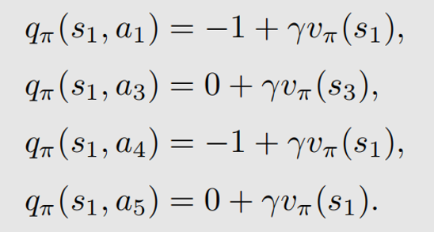
Illustrative example for action value
Highlights:
• Action value is important since we care about which action to take.
• We can first calculate all the state values and then calculate the action values.
• We can also directly calculate the action values with or without models.

Slide 42
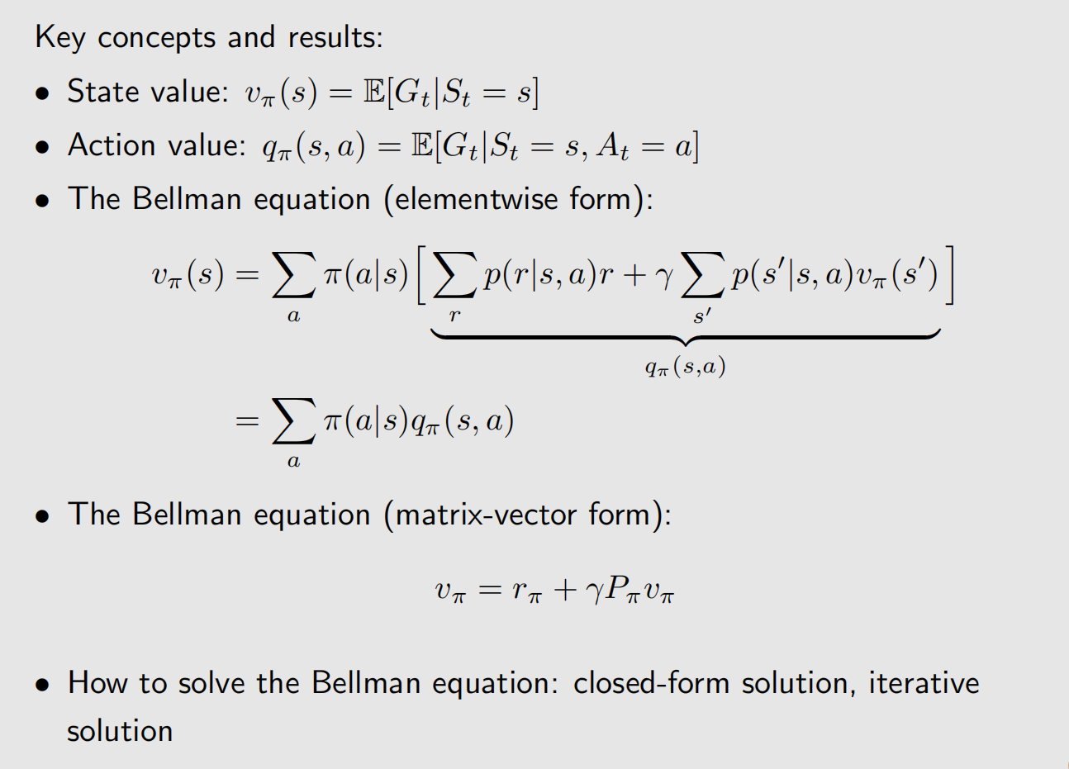
Summary

